Slide 1
Global Warming UK GREENHOUSE GAS EMISSIONS 1990-2020
Project 1 – Group 4
Grace Cheuk (gw-sc)
Navindeep Bains (navinbains)
Salma Abdirahman (Salma-Abdirahman)
Farjana Rowther (fbrowther)

Slide 2
Agenda
01. Introduction
2. Who?
What we’re looking at and why we chose it
Which Sector produces the most emissions?
Which End User is responsible for most emissions?
03. What?
04. How?
05. Closing
Which fuel used contributes to the most?
How much of our activities has changed over the course of time ?
Final conclusions and analysis.

Slide 3

INTRODUCTION
Climate Change -
Many part of the world is experiencing extreme weather patterns that seem to be increasing in volatility by the year. (South Asia, India, Pakistan, USA)
Greenhouse Gases -
They encapsulates the atmosphere trapping the heat from escape to the space
Weather Systems -
Warming effect of the greenhouse gases has a devastating impact on the weather systems
UK Focus -
For the past decade, UK had extremes of weather conditions such as floods, extreme hot and cold seasons
Notes:
In the light of all the news we hear about that COVID impacting positively on environment and the COP meetings etc, we wanted to look at how UK fares with regards to the greenhouse emission profile and whether our behaviour has changed over time?.

Slide 4
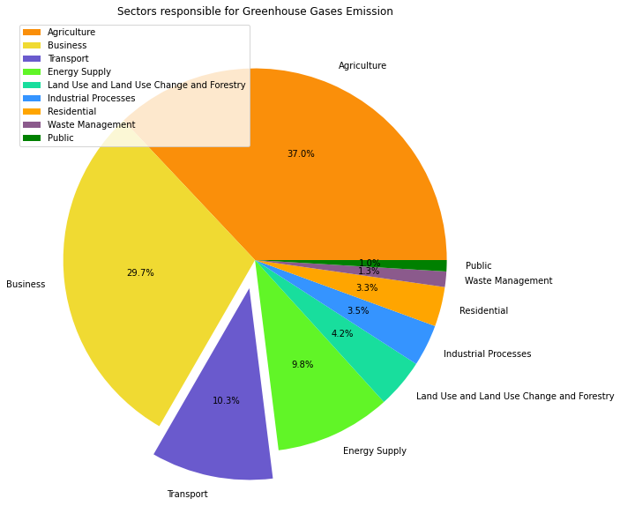
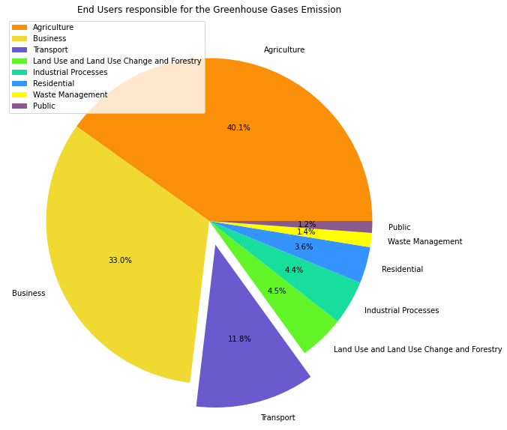
WHO?
WHICH SECTOR EMITS MOST
WHICH END USERS EMITS MOST
Notes:
We have analysed the data for both source and end-users.
This what we see
Unlike the popular belief that transport is the most important driver of the global warming, we noticed agriculture, followed by Business, Transport, Energy supply and Land use, are the top contributors of the greenhouse gas emission accounting to 87%. Therefore, from this point on we decided to concentrate on these sectors and look into them further

Slide 5
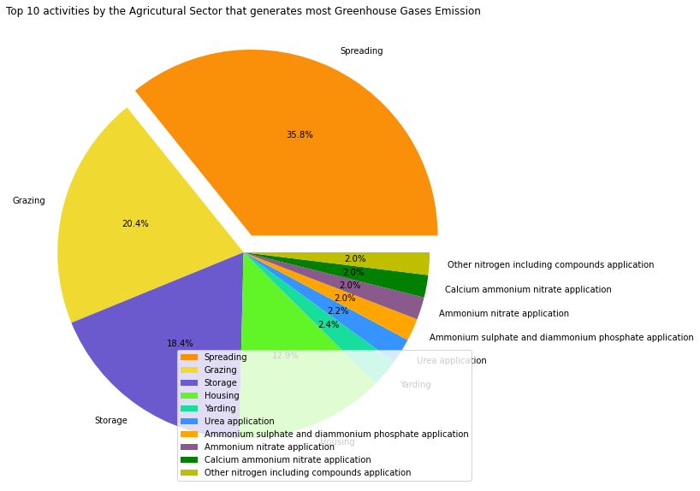
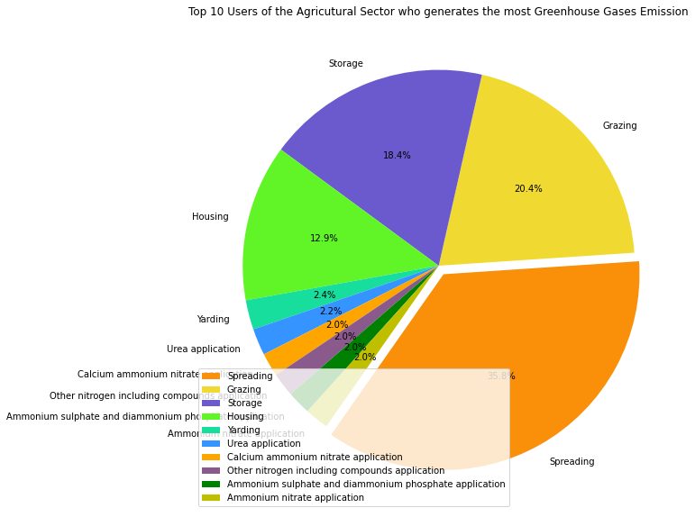
1st Contributor – Agriculture Sector
SOURCE
END-USERS
Notes:
Agriculture is the top contributor to emission (37%), we looked at the majot activities within this sector to understand the problem of emission further.
Spreading constituted for the most, followed by grazing, storage (of agriculture produce) and housing for animals.
When compared the analysis between source and end-users, the results was identical

Slide 6
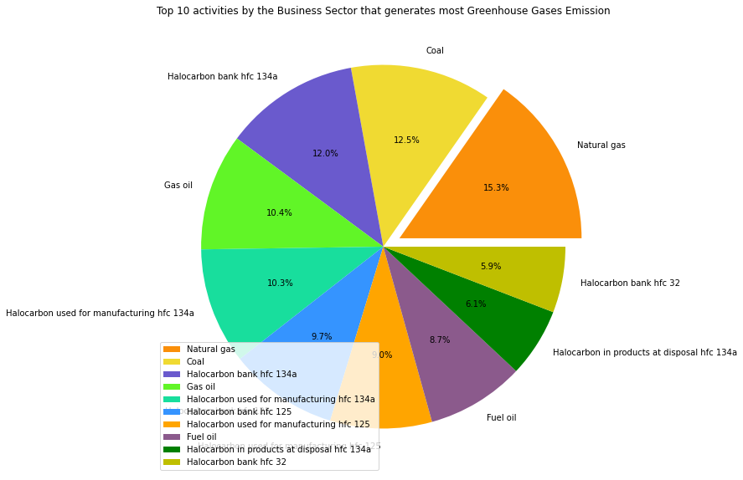

2nd Contributor - Business Sector
SOURCE
END-USERS
Notes:
Secondly, we looked at business sector in detail. The top 10 activities within the business sector made use of either
(1)
natural gas, coal, gas oil, fuel oil for industrial combustion
or
(2) made use of various hydroflurocarbons (hfc 134a, hfc 125) in refrigeration and air conditioning.
Other industrial use also included Power plants,and manufacturing industries.

Slide 7
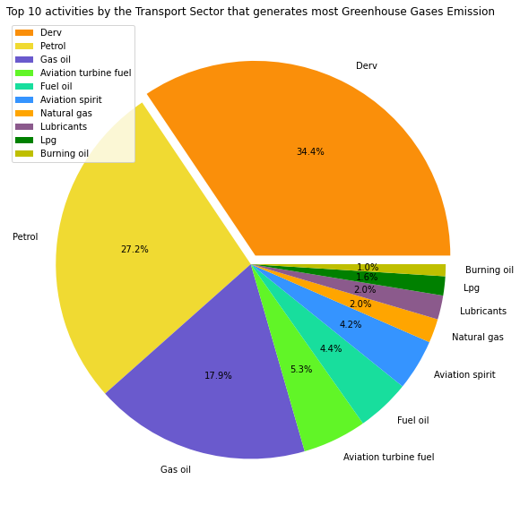
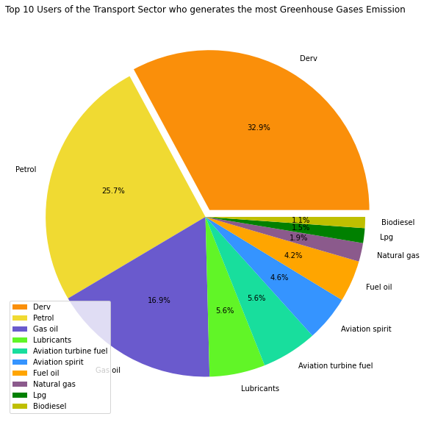
3rd Contributor - Transport Sector
SOURCE
END-USERS
Notes:
Now coming to the third most contributing sector which is transport, top activities included the use of diesel oil, Petrol, Gas oil, Aviation turbine fuel, Fuel oil, Aviation spirit, Natural gas, Lubricants, Lpg, Burning oil, Coal, Biodiesel, etc
These were used in HGVs, passenger cars, light duty vehicles, buses, military aircraft, civil aviation, fishing vessels, national navigation, railway combustion, and motorcycles.
As before the results from source or end-users were identical

Slide 8
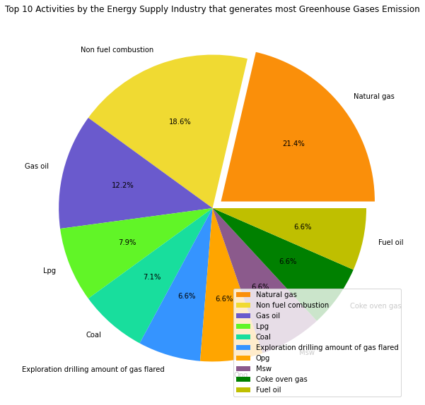
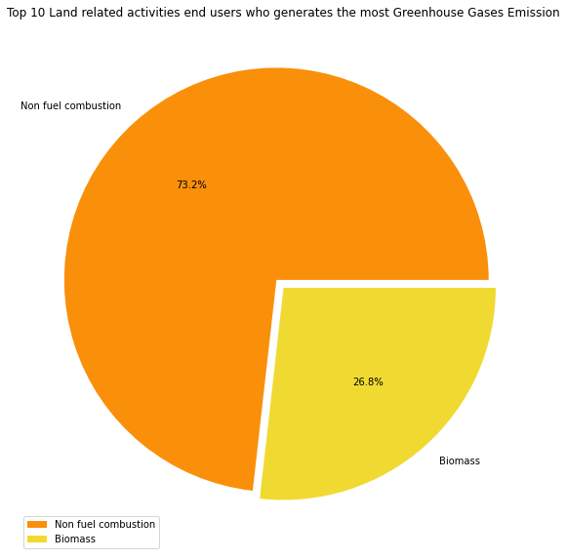
4th Contributor – Energy/Land-related Sector
SOURCE - ENERGY
END-USERS - LAND-Related
Drainage of organic soils (releases CO₂ and NO₂ into the atmosphere)
Farming (Cropland)
Wetland - Plants growing in wetlands emit methane to the atmosphere.
Biomass Burning (Forest fires)
Notes:
Unlike the top three, the fourth contributors to the emission diverged at this point. When we looked at the data from the source point of view, it was the energy supply sector that faired 4th place and when looked at from the end-users it was the Land use related activities that contributed the most.
Major activities of the energy sector included
the use of natural gas, non-fuel, Gas oil, Lpg, Coal, Fuel oil etc for power stations, refineries, and manufacturing of solid fuels.
while the top most land use -related activities include Non-fuel-combustion and Biomass.
Non-fuel consumption - Drainage of organic soils releases CO2 and NO2 into the atmosphere),
Farming (Cropland),
certain species of plants growing in wetlands emit methane to the atmosphere.
Biomass - burning of grassland, crop land, forest land and settlements

Slide 9
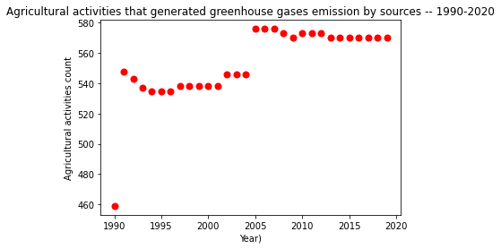
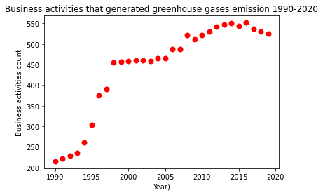
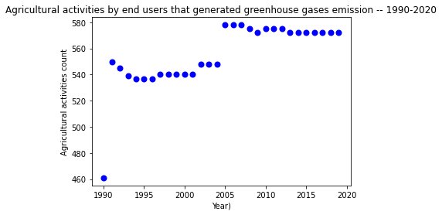
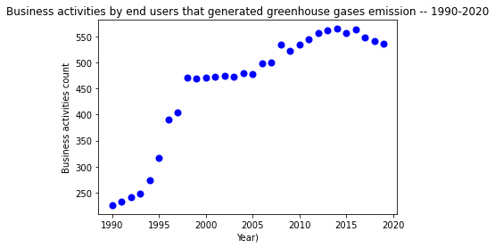
Contributor’s Trend- Agriculture & Business sector
SOURCE v/s END-USERS TREND 1990 -2020
Notes:
Here we wanted to determine the trend in the activities of the sectors over time (1990-2020) to see if they has been a chnage
We have grouped the entire dataset based on sector and looked at the trend in their activities for the whole duration of the dataset.
Here you could see there has been a both continual and upwards trend contributing consistently to the greenhouse gases emission

Slide 10
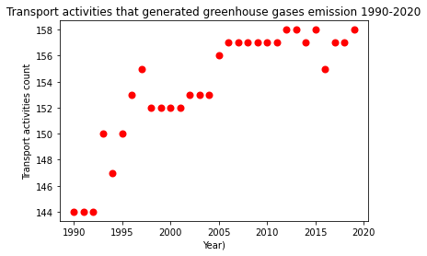
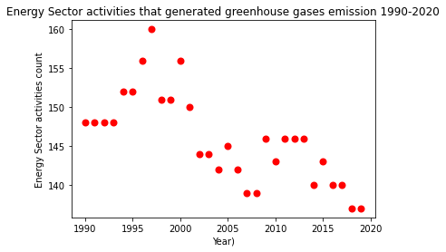
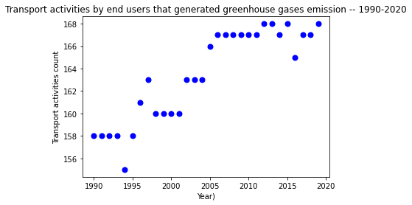
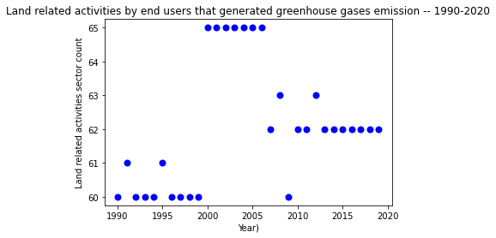
Contributor’s Trend- Transport & Energy/Land sector
SOURCE v/s END-USERS TREND 1990 -2020
Notes:
This upward trend continued on for the transport sector too.
However, in case of the energy sector there has been a slow but definite downward trend. I am not sure whether this downward movement is due to UK governments initiative to phase out of coal plants by 2025 or not?
However, with our looming energy crisis, whether they would be able to stick to their plan or not, is to be seen

Slide 11
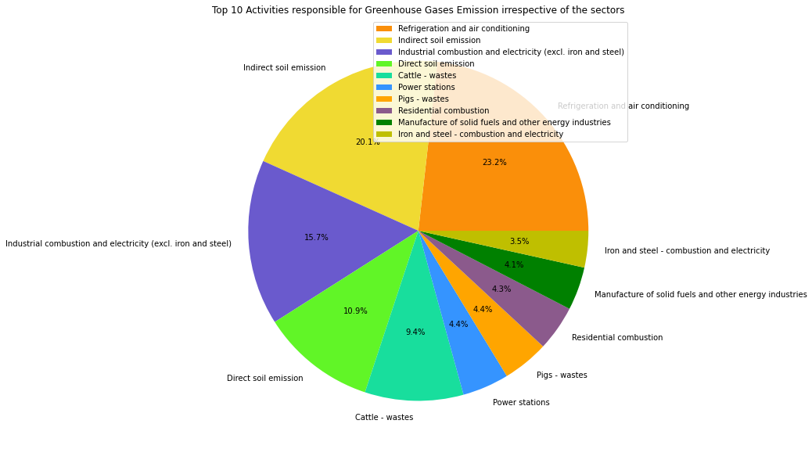
Top 10 contributors irrespective of sector
BY BOTH SOURCES & END-USERS
Notes:
In order to summarize what we have presented so far with regards to sectors we looked at major activities irrespective of sectors.
Here we can see it is
industrial combustion,
agricultural soil management,
refrigeration and air conditioning
that contributes to more than 80% of the emission.

Slide 12
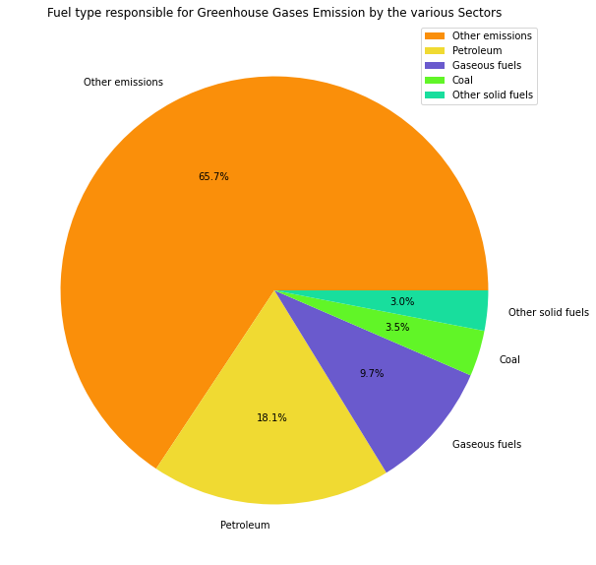
Fuel-Type
SOURCE & END-USERS
Other Emissions include –
Cattle, Horses, Pig and Poultry wastes
Soil emission (both direct and indirect),
Drainage of organic soils - settlements
Waste incineration,
Refrigeration and air conditioning,
Glass Production,
Gas flare,
Chemical Industries,
Power stations,
Industrial combustion,
Manufacture of solid fuels and other energy industries.
Notes:
Petroleum & coal contribute to 1/3rd of emissions.
2/3rd other emissions; manufacturing, industrial combustion, refrigeration & air conditioning.

Slide 13
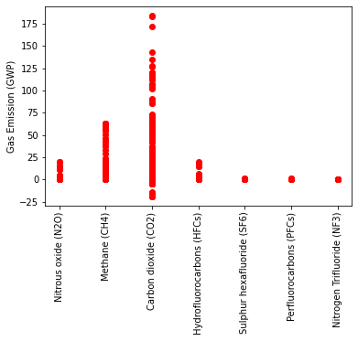
Composition of Greenhouse Gases
BY BOTH SOURCE & END-USERS
1. Carbon dioxide (CO₂)–
CO₂ causes 80% of global warming and its release is mainly contributed by fossil fuels burning like coal, oil and gas or deforestation.
2. Methane (CH₄)–
Methane possess >80 times the warming power of carbon dioxide for the first 20 years after being released
3. Nitrous oxide (N2O) –
Increased N- based fertilizer use (>50 years) has been responsible for dramatic increase in its emission.
4. Hydrofluorocarbons (HFC) –
HFCs are highly effective at trapping solar radiation (infrared radiation) and redirecting it toward Earth's surface.
Major source of HFCs are refrigeration and air conditioning
Notes:
Datasets from GOVUK have similar results to US.
Both that CO2 has the highest emissions – burning of fuels like coal & gas = 80% of global warming.
2nd is Methane = 1st 20 years emissions appro 80x more warming compared to C02.
N2O use in agricultural industry as fertiliser at 3rd.
4th is Hydrofluorocarbons = effective greenhouse gas.

Slide 14
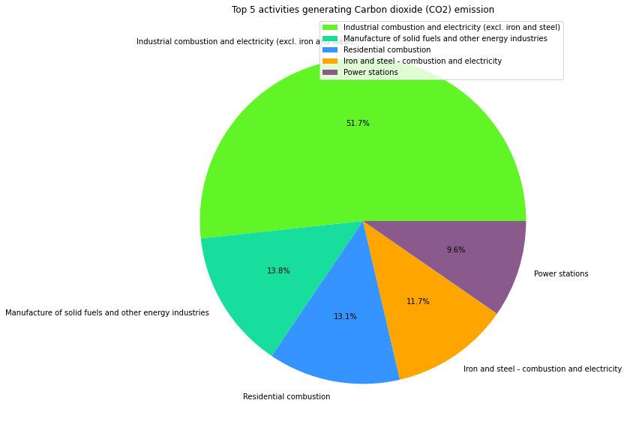
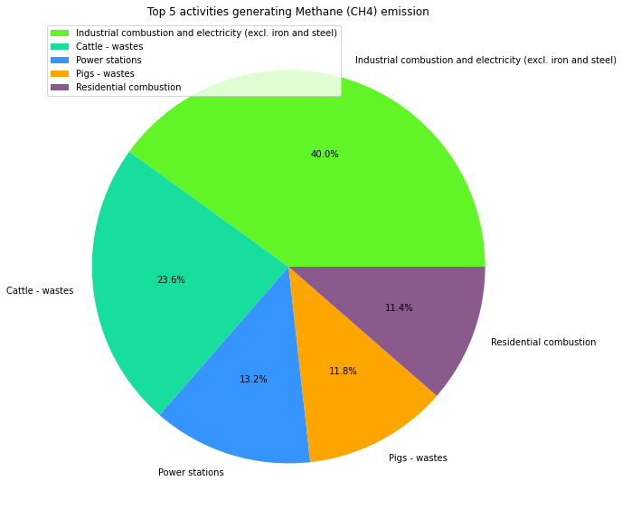
Top Emitters of -
CO₂
Methane
Notes:
Methane & CO2 have large industrial combustion and electricity.
CO2 followed by solid fuels manufacture.
Methane followed by cattle at 2nd – large industry, 2020 there were 9.36 million cattle.

Slide 15
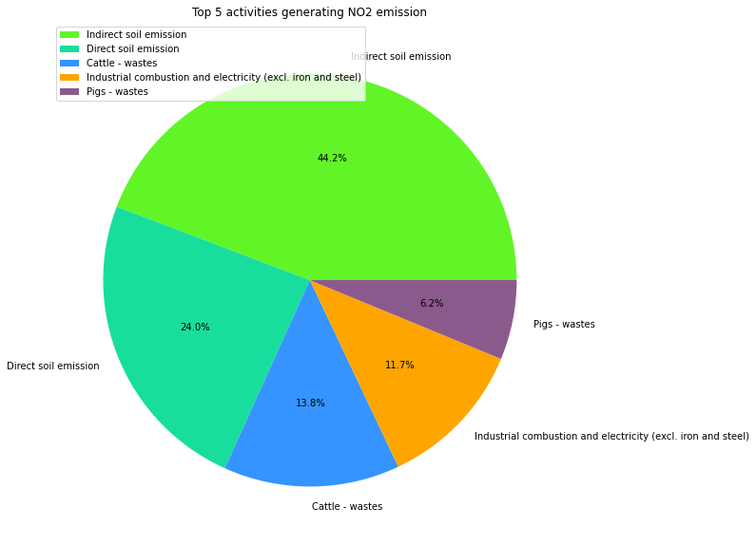
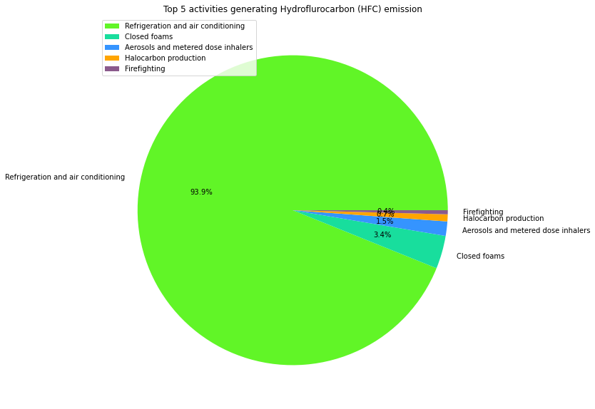
Top Emitters of -
N₂O
Hydrofluorocarbons
Notes:
Methane & CO2 highest emitters = industrial combustion & electricity // not N2O and hydrofluorocarbons.
N2O its only at 4th // 2 largest = soil emission; indirect (fertiliser runoff) & direct (into the atmosphere).
N2O pie chart activities are majority in agricultural and livestock industry.
// No emitter takes up more than ½ except for hydrofluorocarbons at 93.9%.

Slide 16

SUMMARY
WHO – MAJOR SECTORS RESPONSIBLE
TOP ACTIVITIES
Refrigeration and air conditioning,
Soil emission (direct and indirect),
Industrial combustion,
Animal wastes,
Power stations,
Residential combustion,
Manufacture of solid fuels and other energy industries.
Agriculture,
Business,
Transport,
Energy
Land-related activities
TREND
CONCLUSION
There still exists an upward trend in the activities of the major contributing sectors for GG emission
The policy makers need to take stringent urgent measures that ensures current practices are rapidly transformed to slow the emission
Alternatively, we should also look into modalities to capture and transform already released gases, to limit its damages.
Notes:
Finally, i want to summarize what we have found so far.
With the help of this project we were able to identify the top most sectors that were contributing to around 90% of the emission.
Within these sector we were able to look deeper into what major activities that was responsible for the emission.
We also looked at the trend of the activities of the sectors to see if there has been any changes pertaining to more recent extreme weather conditions.
Last, but not the least we were able to conclude the studies on the following -
(1) we noticed an upward trend in the activities of the top responsible sector. thus, urging the policy makers to take more stringent measure to both curb and transform the practices of these sectors and finally we suggest we look into modalities that can be used to capture already released greenhouse gases, from the atmosphere and limit its damage.

Slide 17

Thank you
Group 4
Notes:
We can take your questions!

